Slide 1
Welcome to P.I.N. Grade 7 Life Science
Mrs. Kristen Musto

Slide 2
(Not pictured: Fish rescued from former experiments)
Family

Slide 3
My website: kmusto.weebly.com
http://kmusto.weebly.com/

Slide 4
Education and Experience
Initial license in Biology, 5-8, 8-12- Framingham State University
B.S. in Molecular and Cellular Biology- University of Connecticut
Teaching experience-Year 3 at Blake MS, Westwood HS, Canton HS, and Dover-Sherborn HS
Volunteering/substitute teaching in Medfield Schools
Pharmaceutical Sales
Pharmaceutical and Biotech Research

Slide 5
My Teaching Philosophy:
“Tell me and I forget. Teach me and I remember. Involve me and I learn”
~Benjamin Franklin
It is my belief that a successful science classroom is one that allows students to be immersed in heuristic learning; one that allows them to challenge and ask questions, and more importantly, make mistakes and learn from them.

Slide 6
POINT SYSTEM: QUIZZES= 10-20 HOMEWORK= 10% of total points PROJECTS= 20-50 TESTS= 30-70 SMALL LABS/ACTIVITIES= 2-20 SCIENCE EXPLORATION= 5% of total points
GRADING
BAR SYSTEM

Slide 7
My 2 main “golden rules”:
#1 Be respectful
#2 Be resourceful

Slide 8
Here’s a few things your child will learn this year:
Collaboration and Project-based learning
Laboratory skills-measuring, using microscopes, conducting well-designed experiments!
How to analyze data and draw conclusions!
Creativity and innovation!
Critical thinking and problem-solving skills!

Slide 9
iPad Projects
The Cell Project
The Cell Cycle
Membrane Transport

Slide 10
Project-Based Learning
http://savethecooters.weebly.com/
http://bogturtlema.weebly.com/
http://easternwormsnake.weebly.com/

Slide 11
Nature’s Classroom
In Silver Bay, New York

Slide 12
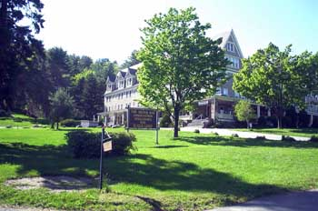
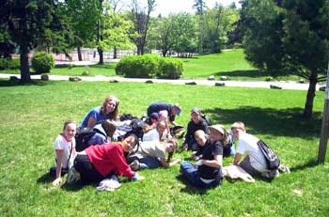
Explore…

Slide 13
Trout in the Classroom
Raised in our classroom;
released into the Charles River!

Slide 14
Tips for success in 7th Grade Life Science and Beyond…
Complete Reading Notes outline. Use it as a reference sheet throughout unit and to check for understanding.
Make sure that you review vocabulary that you aren’t familiar with.
Do all homework assignments. Give it your best try (it’s okay to have an incorrect answer).
Use your class time wisely.
Keep all class handouts organized in your binder.
Take some time to understand figures and diagrams from class and your textbook.
Study frequently and in small doses. You will never learn material by cramming!
Set up a study group and study with friends.
If you have any trouble with the material, get help early. Do not wait until the TEST DAY!

