Slide 1
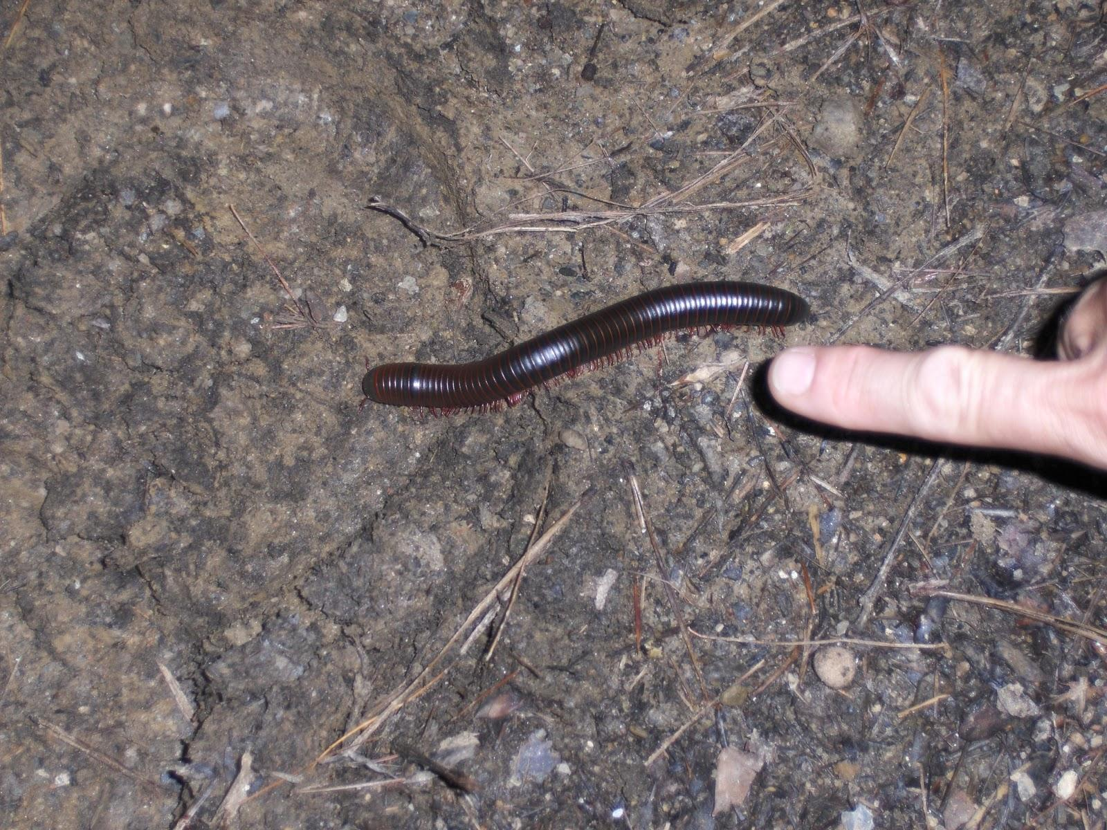
Characteristics of Life

Slide 2
1. Living Things Have ______
a _______- covered structure that contains all the materials necessary for life and has all the characteristics of life.
_____ celled- an organism made of one cell
__________ - We are multicellular and each cell has its own function
An adult human has over 100 trillion cells

Slide 3
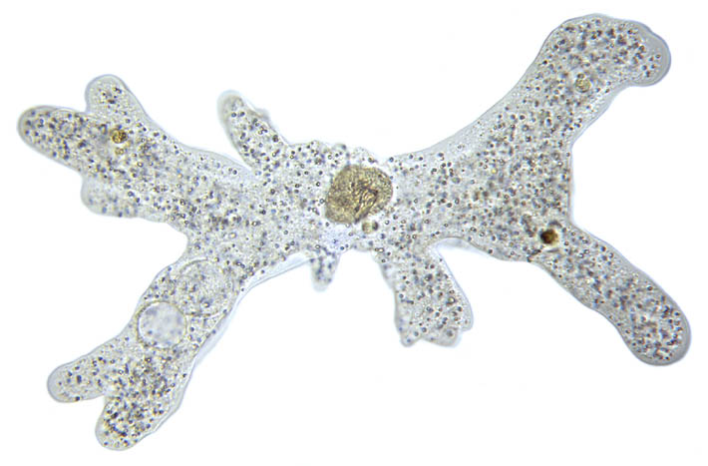
Single Cell
www.biologycorner.com

Slide 4
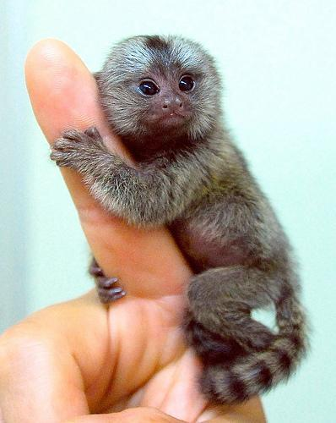
Multicellular
www.flickr.com

Slide 5
2. Living Things Sense and Respond to Change
The change that an organism reacts or responds to is called a ____________.
Mimosa leaf plantsinmotion.bio.indiana.edu

Slide 6
Homeostasis
Living things need to _______ to their internal environment to maintain a ______ state.
http://www.flickr.com/photos/jayjayc/76115536/
http://www.terradaily.com/images/shiver-cold-person-sm.jpg

Slide 7
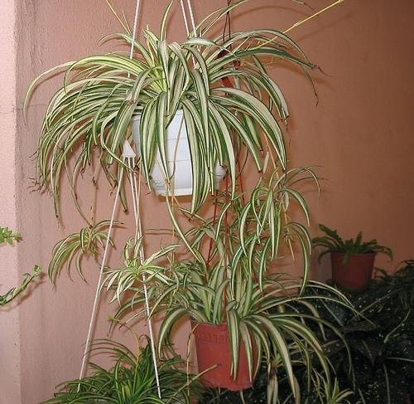
3. Living Things Reproduce
__________ reproduction- a single parent produces offspring with the ______ genetic material (DNA).
Binary Fission
http://www.flickr.com/photos/jayjayc/76115536/

Slide 8
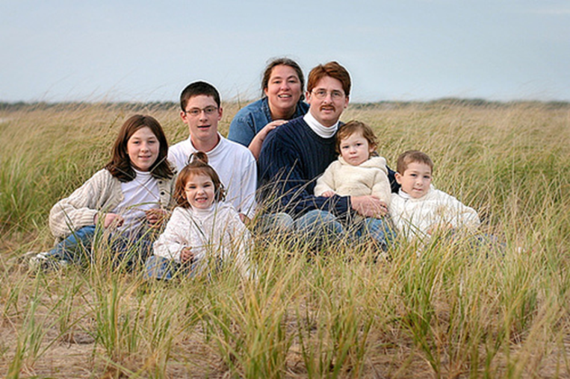
Sexual reproduction- two parents share genetic material (DNA) to produce offspring.
Sperm- the ______ sex cell
Egg- the _______ sex cell
The mixing of genetic material creates organisms that look ___________.

Slide 9
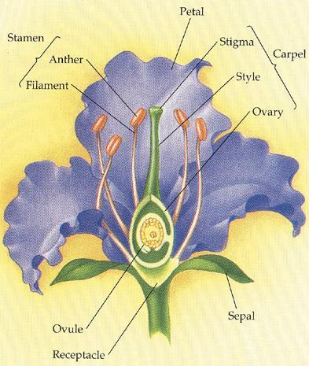
Sperm cells are found here!
http://www.sccs.swarthmore.edu/users/00/aphilli1/cpd/parts.html
Egg cells are found here!

Slide 10
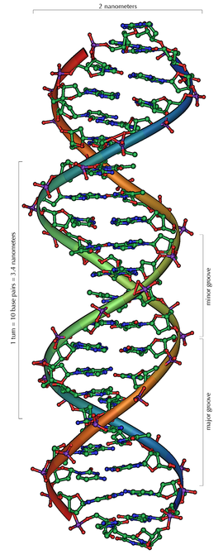
4. Living Things Have DNA
DNA Video
DNA provides
________________ for
making proteins.
The passing of DNA
to offspring is called _______.

Slide 11
5. Living Things Use Energy
Living things use energy to ______ the chemical reactions that break down food, move things in and out of the cell, move, grow, reproduce, and much more.
Organisms use ______ to make the energy they need in a process called cellular respiration.
Plants are producers and make their own food in a process called _____________________.
Other organisms will be consumers or decomposers.
_______________ is the total of all the chemical activities in a cell.

Slide 12
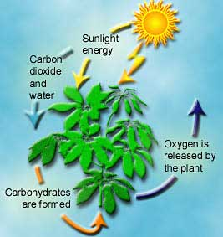
Photosynthesis
http://athene.as.arizona.edu/~lclose/teaching/a202/Photosynthesis_20in_20a_20Plant.jpg

Slide 13
http://www.adinstruments.com/applications/images/cell_respiration.jpg

Slide 14
6. Living Things Grow and Develop
Growth - single-celled organism gets _______.
Growth- multi-celled organisms add more ___.
Develop- living things change as they grow. Organisms pass through different stages as they grow.
Metamorphosis is when the development of an organism includes a ________ of body shape.

Slide 15
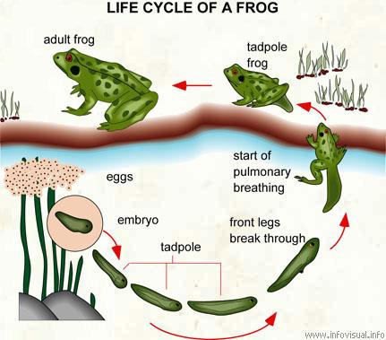
http://www.infovisual.info/02/029_en.html

