Slide 1
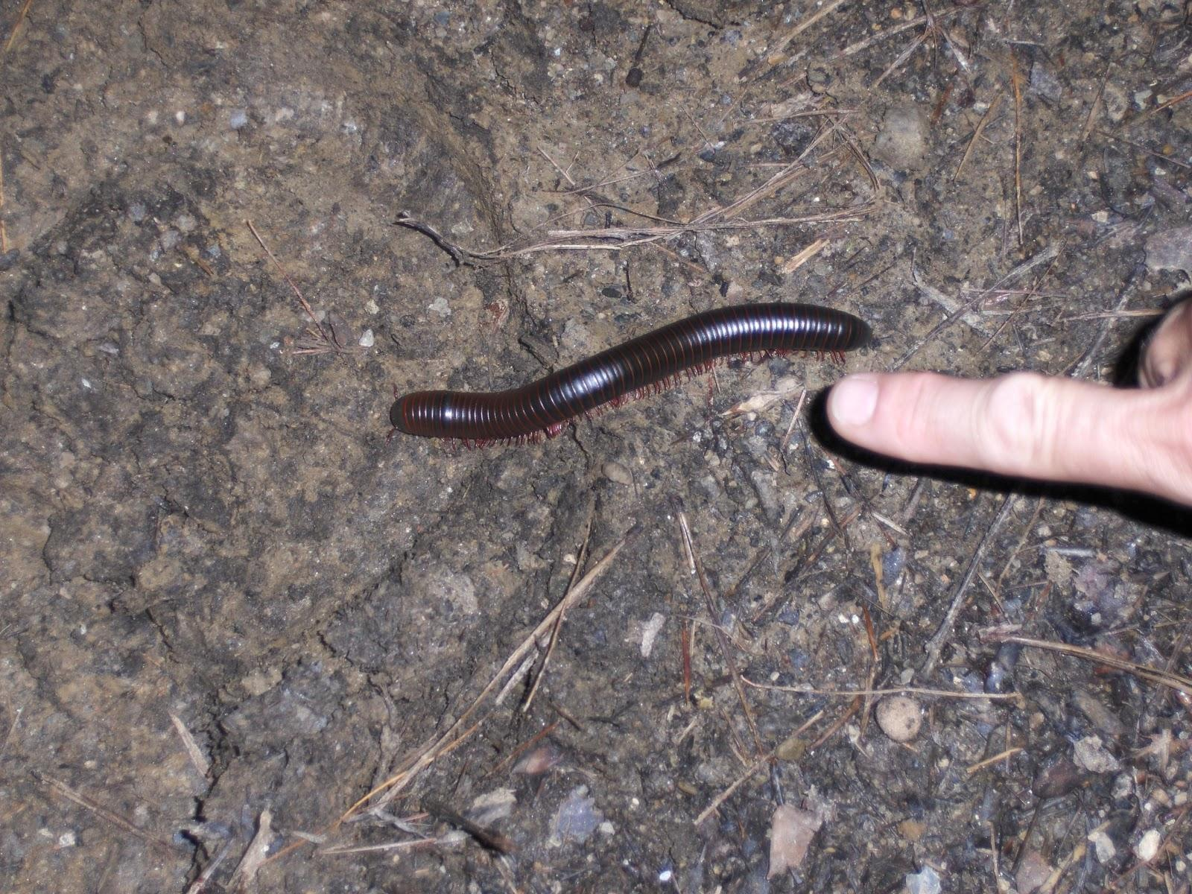
Characteristics of Life

Slide 2
1. Living Things Have Cells
a membrane- covered structure that contains all the materials necessary for life and has all the characteristics of life.
Single celled- an organism made of one cell
Multicellular - We are multicellular and each cell has its own function
An adult human has over 100 trillion cells

Slide 3
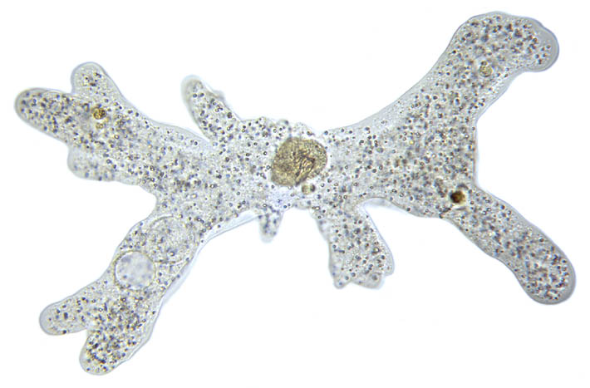
Single Cell
www.biologycorner.com

Slide 4
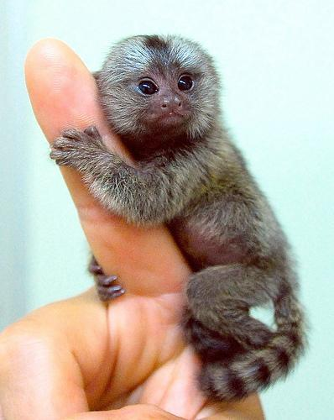
Multicellular
www.flickr.com

Slide 5
2. Living Things Sense and Respond to Change
The change that an organism reacts or responds to is called a stimulus.
Mimosa leaf plantsinmotion.bio.indiana.edu

Slide 6
Homeostasis
Living things need to respond to their internal environment to maintain a stable state.
http://www.flickr.com/photos/jayjayc/76115536/
http://www.terradaily.com/images/shiver-cold-person-sm.jpg

Slide 7
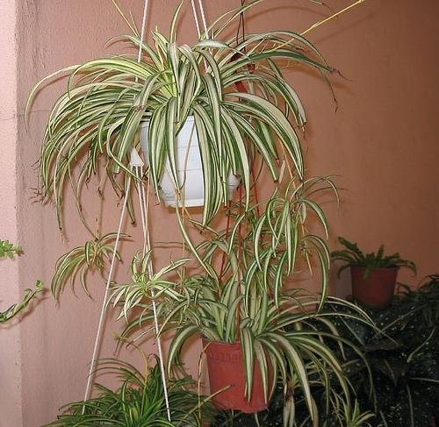
3. Living Things Reproduce
Asexual reproduction- a single parent produces offspring with the same genetic material (DNA).
Binary Fission
http://www.flickr.com/photos/jayjayc/76115536/

Slide 8
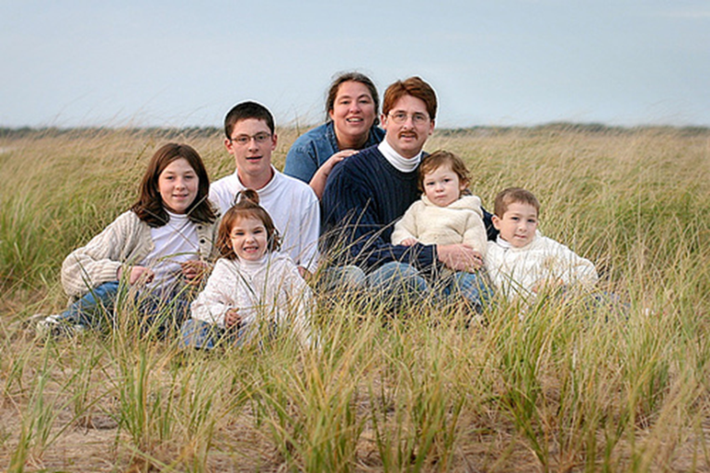
Sexual reproduction- two parents share genetic material (DNA) to produce offspring.
Sperm- the male sex cell
Egg- the female sex cell
The mixing of genetic material creates organisms that look different.

Slide 9
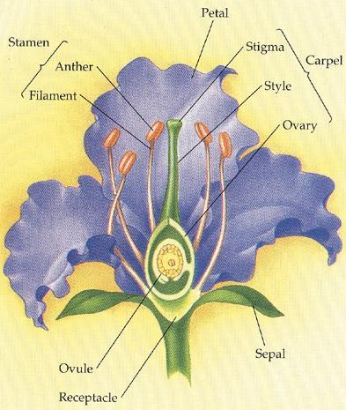
Sperm cells are found here!
http://www.sccs.swarthmore.edu/users/00/aphilli1/cpd/parts.html
Egg cells are found here!

Slide 10
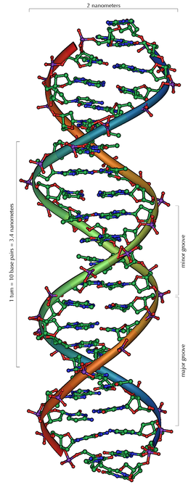
4. Living Things Have DNA
DNA Video
DNA provides
instruction for
making proteins.
The passing of DNA
to offspring is called heredity.

Slide 11
5. Living Things Use Energy
Living things use energy to power the chemical reactions that break down food, move things in and out of the cell, move, grow, reproduce, and much more.
Organisms use food to make the energy they need in a process called cellular respiration.
Plants are producers and make their own food in a process called photosynthesis.
Other organisms will be consumers or decomposers.
Metabolism is the total of all the chemical activities in a cell.

Slide 12
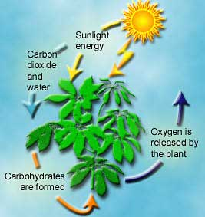
Photosynthesis
http://athene.as.arizona.edu/~lclose/teaching/a202/Photosynthesis_20in_20a_20Plant.jpg

Slide 13
http://www.adinstruments.com/applications/images/cell_respiration.jpg

Slide 14
6. Living Things Grow and Develop
Growth - single-celled organism gets larger.
Growth- multi-celled organisms add more cells.
Develop- living things change as they grow. Organisms pass through different stages as they grow.
Metamorphosis is when the development of an organism includes a change of body shape.

Slide 15
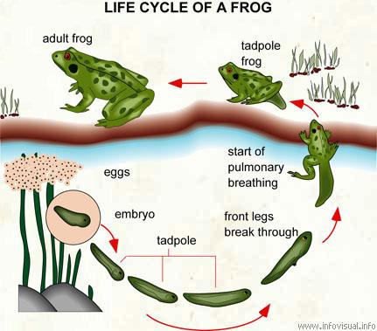
http://www.infovisual.info/02/029_en.html

